Slide 1

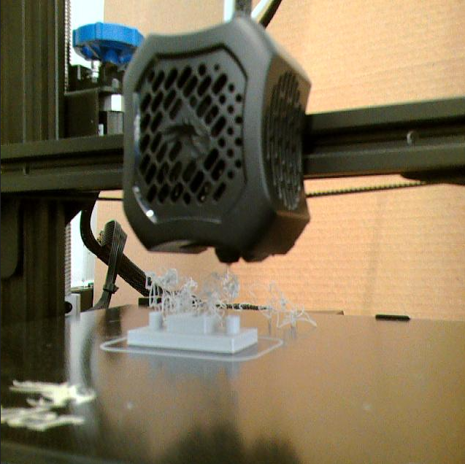
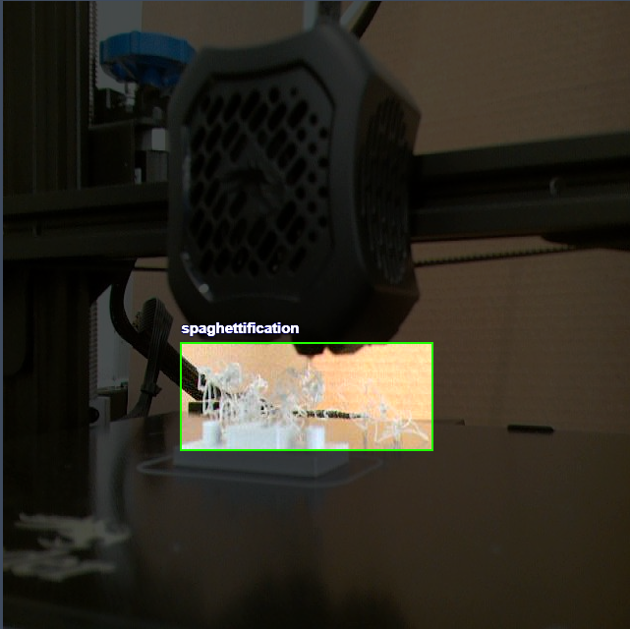
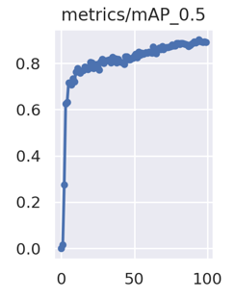
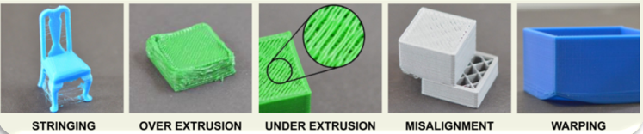
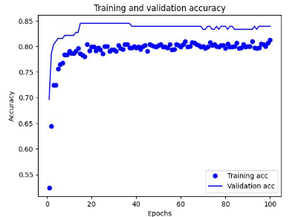
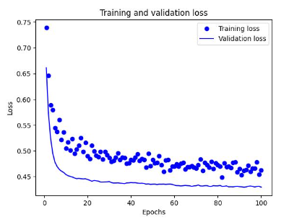
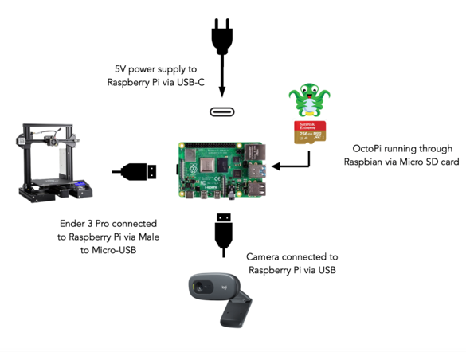
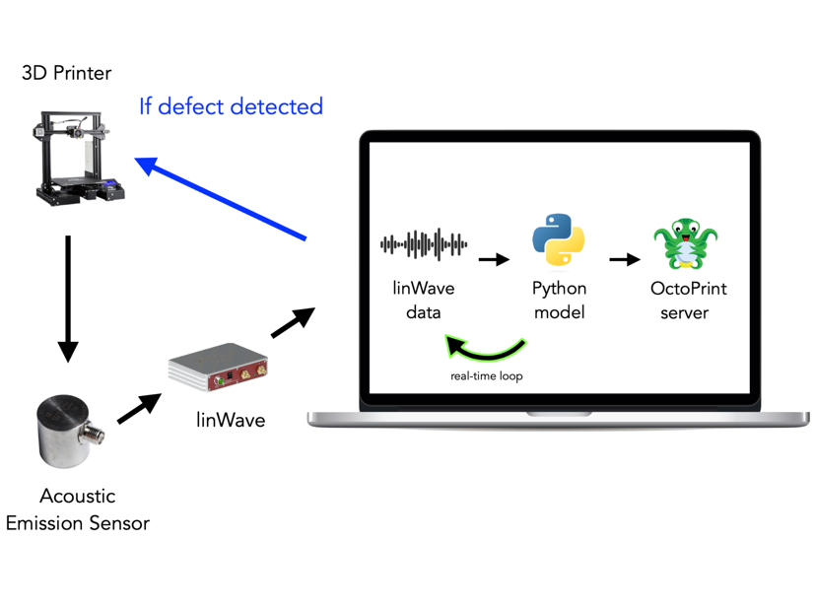
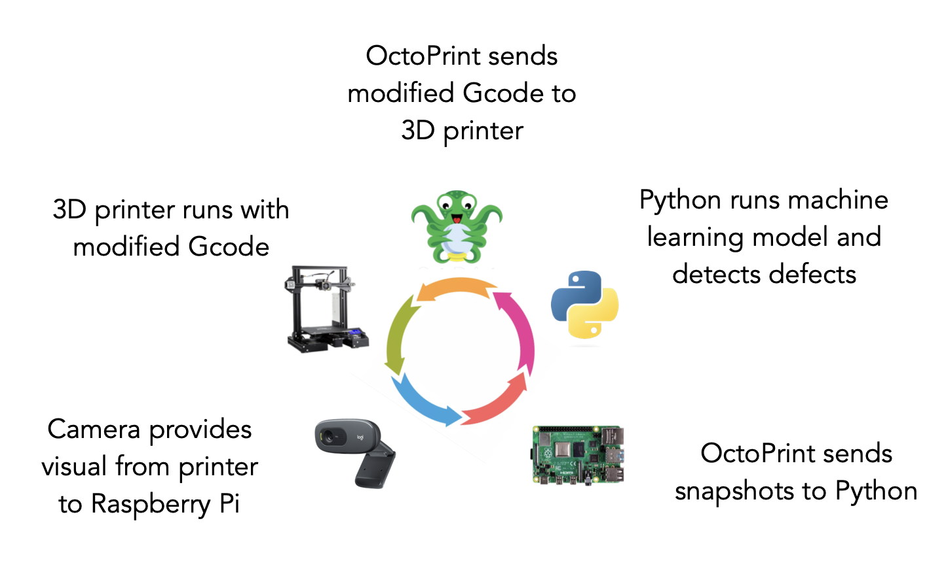
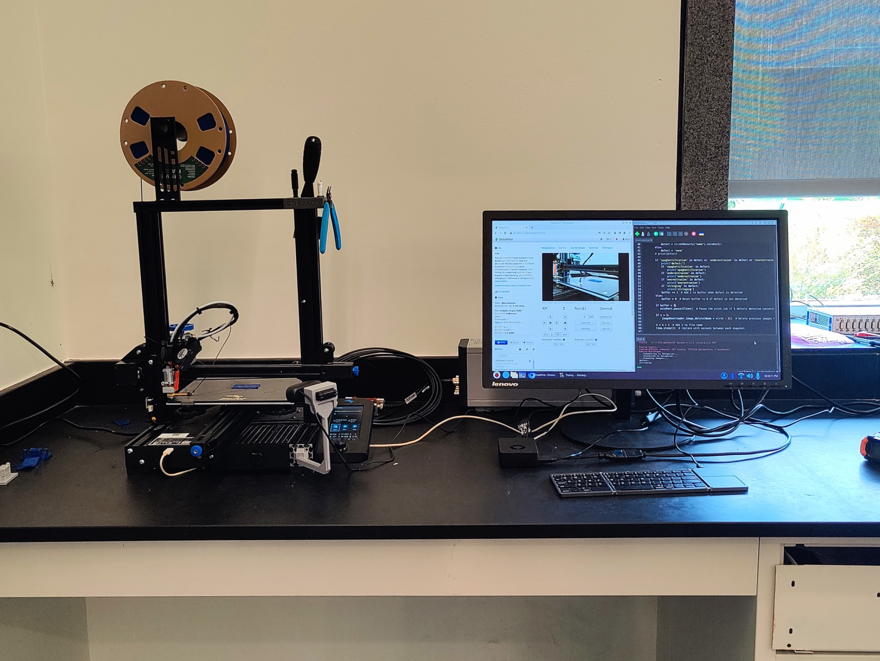
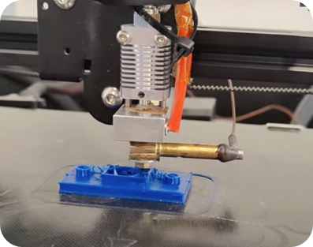
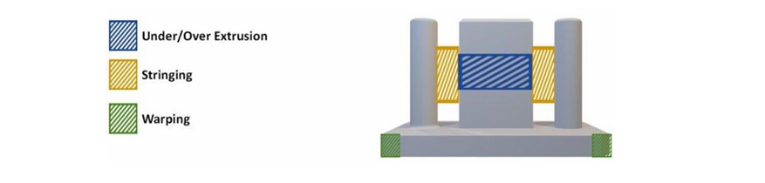
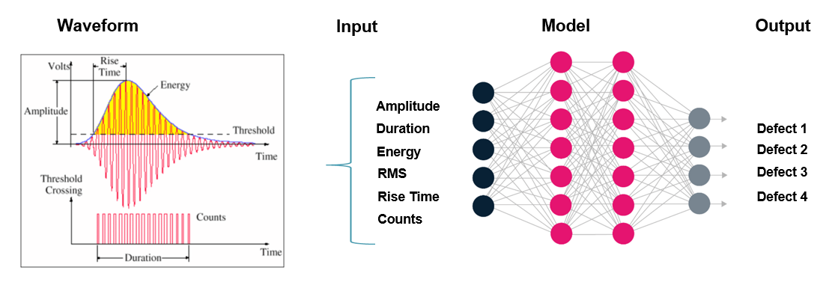
A Deep Learning Approach For 3D Printing Monitoring
Ahmed Ben Sidhom, Antonios Kontsos
Digital Engineering Hub (DEHub),Department of Mechanical Engineering
Rowan University, Glassboro, New Jersey, US
IINTRODUCTION
METHODS
RESULTS & DISCUSSION
3D printing represents a significant leap forward in additive manufacturing technology. Despite its promising capabilities, the printing process often encounters various challenges, leading to frequent failures. These issues, such as under extrusion, stringing, and spaghettification, are diverse and recurrent, significantly impeding the seamless execution of print jobs. Consequently, these common errors pose substantial hurdles to the reliability and efficiency of 3D printing technology. These deficiencies can be rectified by having a closed-loop monitoring system, that can see defects and adjust printing properties to remove this defect from the rest of the print.
Class | mAP50
All | 0.902
Spaghettification | 0.786
Stringing | 0.985
Under extrusion | 0.935
Figure 3. Defect detection using YOLO
Figure 1. Example of 3D-Printing Defects
Images are captured during the printing process to detect purposely created defects by altering the G code, then the collected data is used to train an object detection model YOLOv5s, enabling real-time identification of defects. Upon detection, commands are sent through OctoPrint installed on a RaspberryPi to adjust printer settings dynamically, ensuring optimal print quality.
Figure 7. YOLO and DenseNet results
This project introduces an innovative method to improve quality control in 3D printing by integrating real-time image analysis and acoustic emission sensing, enhanced through machine learning techniques:
Detecting and classifying defects in 3D-printed parts by analyzing images captured during the printing process in real time.
Identifying defect occurrence during printing using an acoustic sensor attached to the nozzle, providing real-time feedback on potential issues.
By integrating the two modalities and using both computer vision and time series, this approach demonstrate excellent performance, enabling automated adjustments to optimize print quality and minimize production errors.
Figure 4. Object detection setup
The geometry used to test these errors was a set of two cylindrical pillars with a rectangular tower in the middle.
Figure 8. Deployment and Closed-loop setup
Figure 5. Acoustic Emission setup
This classification models was also deployed in real time which makes both approaches not only serve to identify defects but also contributes to the closed-loop control of the printer in real-time application.
By reducing the number of failed prints, we minimize the waste generated by additive manufacturing, making the process both environmentally friendly and economically beneficial. Since additive manufacturing already produces less waste compared to subtractive methods, this further enhances its sustainability. Additionally, our approach helps increase confidence in the reliability of additive manufacturing.
Figure 2. Proposed geometry
The object was sliced in Cura using default settings, representing a standard configuration for many 3D printers.
To simulate under-extrusion, the g-code was modified to reduce the extrusion rate.
Stringing errors were induced by increasing the printing temperature and disabling retraction in Cura.
Spaghettification errors were generated by instructing the printer to create layers in midair, causing the extruded plastic to lack support and form long curls across the print bed.
Our proposed monitoring system is capable of detecting these three types of print defects and adjusting printing parameters to correct them by:
Modifying nozzle temperature
Adjusting flow rate
Pausing the print
Furthermore, acoustic emission signals generated during the printing process are captured and analyzed to identify patterns associated with various defects. Feature extraction techniques are applied to the acoustic data, and a dense neural network is trained to classify those defects.
ACKNOWLEDGEMENTS
I would like to express my gratitude to Dr. Antonios Kontsos for his invaluable guidance and support throughout this project. I would also like to thank all the members of the Fall 2023 and Spring 2024 clinics for their contributions to data collection and labeling
Figure 6. Acoustic Emission feature extraction
Notes:
The space between the pillars and tower was the testing area for the stringing error. When the printer’s extruder is moved from one position to another, the printer is told to retract the filament a specific amount to prevent stringing. If the filament is not retracted, the filament can slowly leak out of the nozzle, and when that leaking occurs over a space, it presents itself as small strings between those two points. The gaps between the pillars and tower were necessary to create these nucleation points for stringing.

